Slide 1
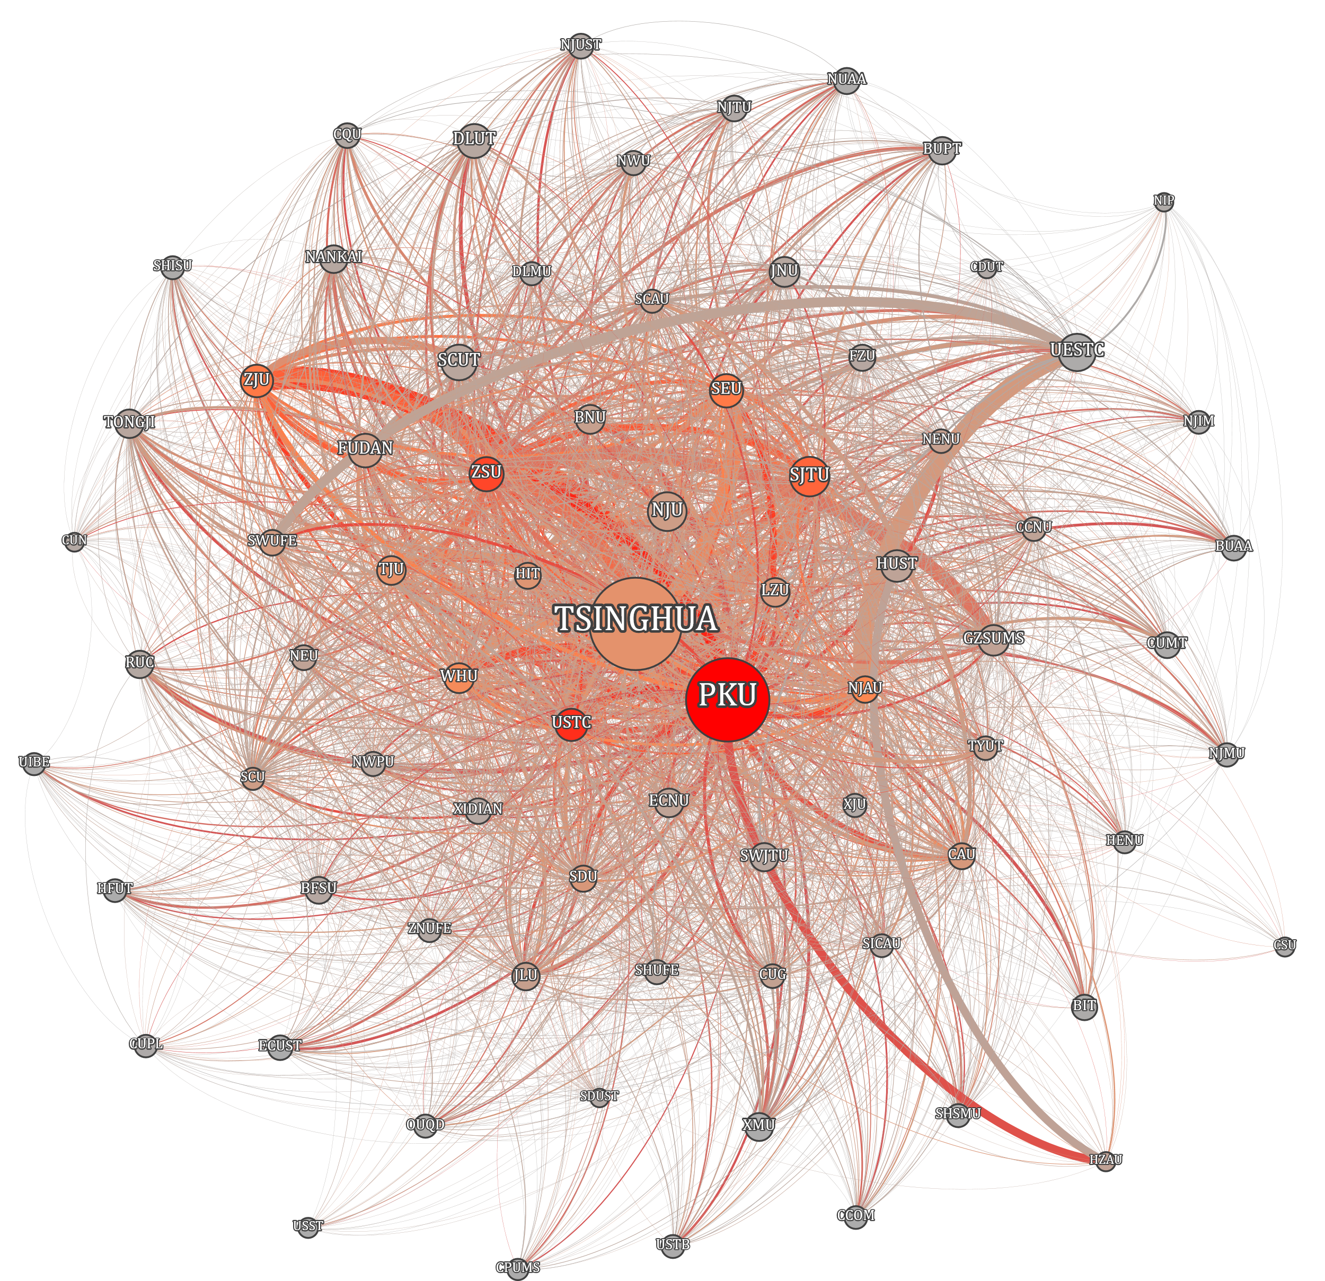
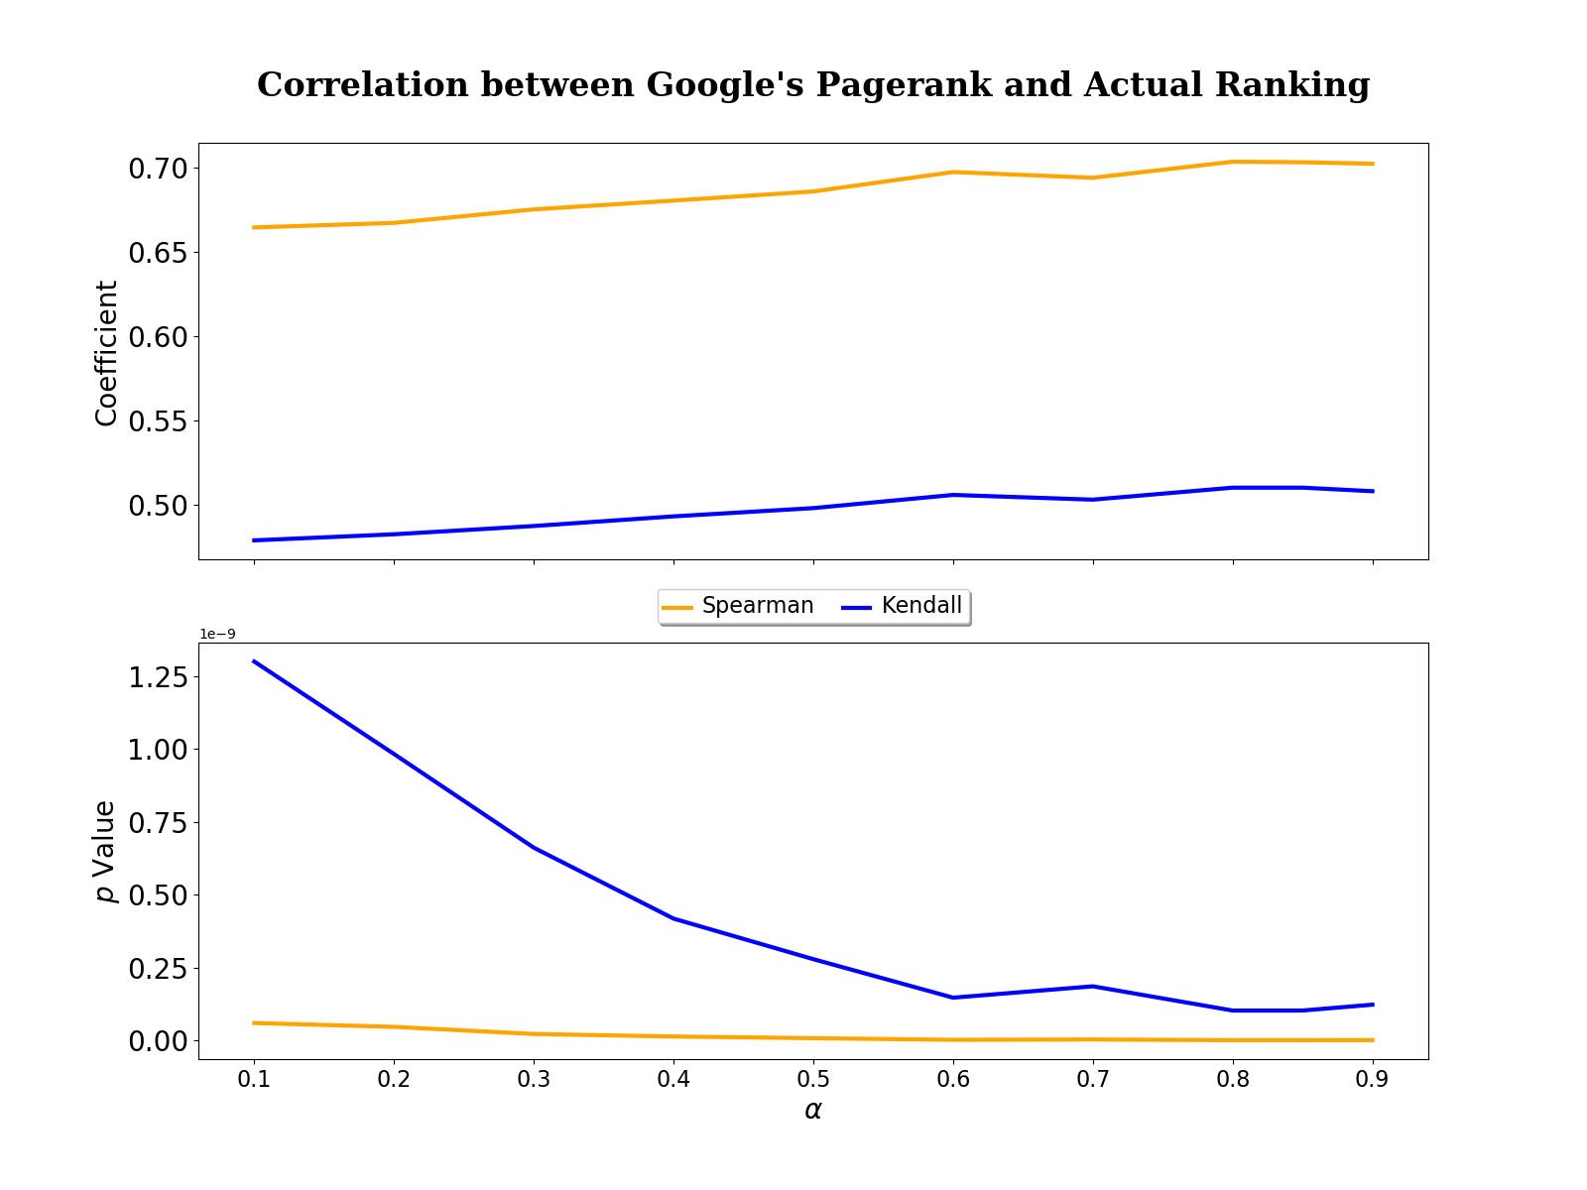
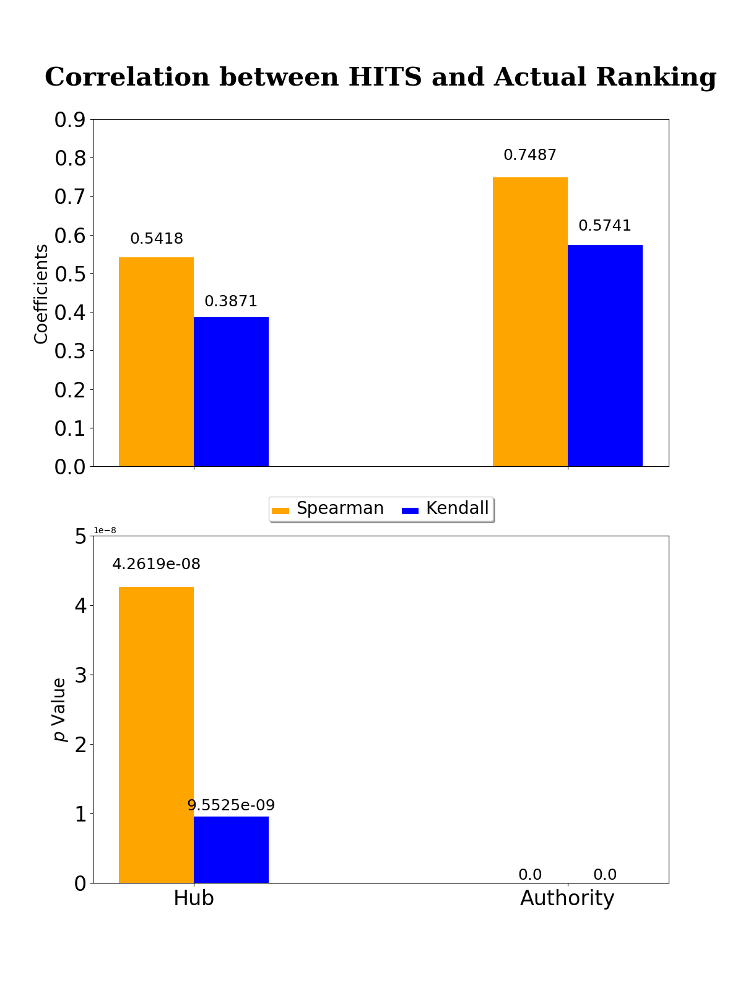
CSIC5011 Mini Project 2 Ranking China’s Universities: A Weblink Analysis Approach GU Hanlin, HUANG Yifei, SUN Jiaze Department of Mathematics HKUST
Introduction & Objectives
Ranking Results & Analysis
University ranking is perhaps one of the most discussed topics amongst students and scholars alike. Higher rankings usually leads to better reputation, which in turn helps attract greater attention from other universities, in a manner similar to citations of academic papers, or for that matter, websites. In this project, we aim to accomplish the following tasks:
Visualize the weblink network of a selection of China’s universities;
Rank the websites of these universities based on the structure of the weblink network;
Examine how the above ranking schemes differ from the actual research rankings
We re-ranked the 76 universities according to Google’s PageRank, HITS Authority and Hub. As a snapshot, the following table shows the top 5 universities for each ranking scheme. An interesting observation is that Tsinghua University drops out of the top 5 in Hub Ranking.
We compared each of the three latter ranking schemes against the actual ranking by computing their respective Spearman’s 𝜌 and Kendall’s 𝜏 coefficients (as well as p values), as shown below.
Rank | Actual Ranking | Google’s PageRank (α=0.85) | HITS Authority | HITS Hub
1 | Peking University (PKU) | Tsinghua University | Tsinghua University | Peking University (PKU)
2 | Tsinghua University | Peking University (PKU) | Peking University (PKU) | University of Science and Technology of China (USTC)
3 | Fudan University | Shanghai Jiao Tong University (SJTU) | Beijing Normal University (BNU) | Sun Yat-sen University (ZSU)
4 | Nanjing University (NJU) | Nanjing University (NJU) | Shanghai Jiao Tong University (SJTU) | Shanghai Jiao Tong University (SJTU)
5 | Zhejiang University (ZJU) | University of Electronic Science and Technology of China (UESTC) | Jilin University (JLU) | Zhejiang University (ZJU)
Table 1. Top 5 universities of various ranking schemes
The Data
The data set describes the weblink network of 76 Chinese Mainland Universities during 2001 to 2002. It contains:
A 76×76 link matrix, W, whose (i, j)-th entry gives the number of links from university i to j
Actual research rankings of these universities during that period
Methodology
We employed 3 methods to rank the websites of these universities: Google’s PageRank, HITS Authority, and HITS Hub.
In order to compare the above ranking schemes against the actual research ranking, we compute Spearman’s 𝜌 and Kendall’s 𝜏 for each comparison.
We used Gephi for the network visualization.
Figure 2. Google’s PageRank vs Actual Ranking
Figure 3. HITS vs Actual Ranking
Conclusion
Tsinghua and PKU top the Google’s PageRank list by a large margin (as seen in Figure 1). HITS ranking shows that Tsinghua is an authority, while PKU is more of a hub.
Extremely small p-values (on the order of 10⁻⁸ to 10⁻⁹) indicate that Google’s PageRank, Hub, and Authority all have strong correlations with the actual ranking. Authority ranking noticeably resembles the actual ranking better than any other methods. On the other hand, Hub ranking differs the most from the actual ranking.
Google’s PageRank result gets gradually closer to the actual ranking as α increases.
Individual Contribution
GU Hanlin: Analysis on correlation
HUANG Yifei: Implementing ranking schemes
SUN Jiaze: Network visualization and poster
The project was carried out collaboratively and everyone contributed equally
Figure 1. A visualization of the weblink network of 76 China’s Mainland universities
The names of the universities are abbreviated according to their website URLs. Both node size and text size represent the university’s Google PageRank score (the larger the size, the higher the PageRank score) with the hyperparameter α set to 0.85. The colour of a node represents its HITS Hub score (the more RED, the higher its Hub score, the more GRAY the lower). Link thickness reflects the number of actual links between two universities’ websites, and outgoing links always have the same colour as its parent node.
Reference
Y. YAO, A mathematical introduction to data science. http://math.stanford.edu/~yuany/ course/reference/book_datasci.pdf, 2017.

